Slide 1
Low Carbon Liquid fuel MANUFACTURING TECHNOLOGY
Providing Fuel Manufacturing Technology to the world for over 20 years.
Because the health of this planet is in our hands.
Provided by: Life Science & Energy Australia
Tel +61426847752
Chris Niemandt

Slide 2
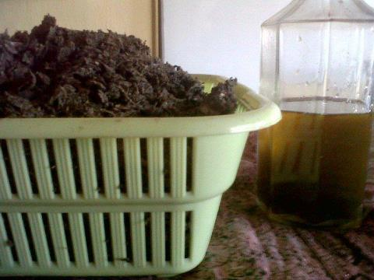
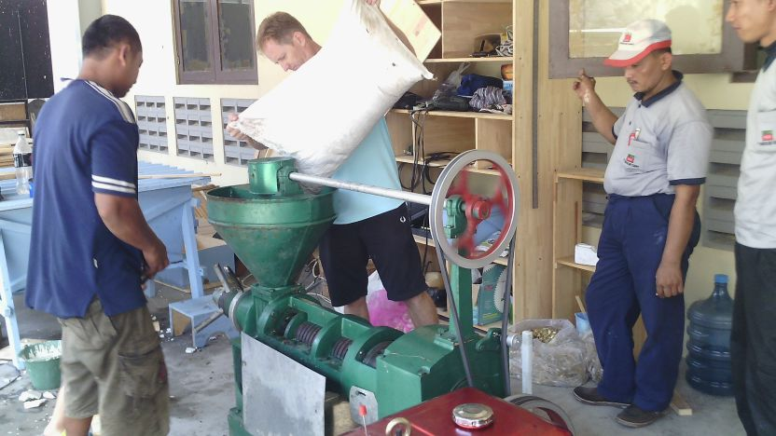
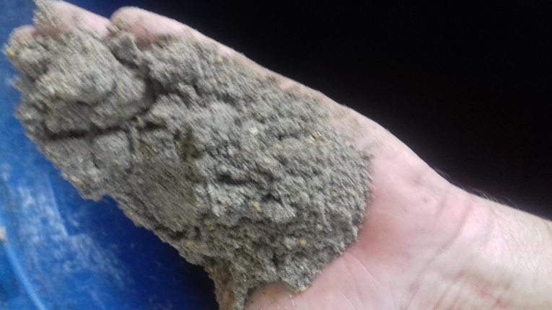
Full Processing technology: Seed to Oil to Fuel & Lubricants
From the Canola or the Sunflower seed, to 100% organic Cooking oil
From Cooking oil to High-End Diesel
Oil Cake to High-End animal Fee

Slide 3
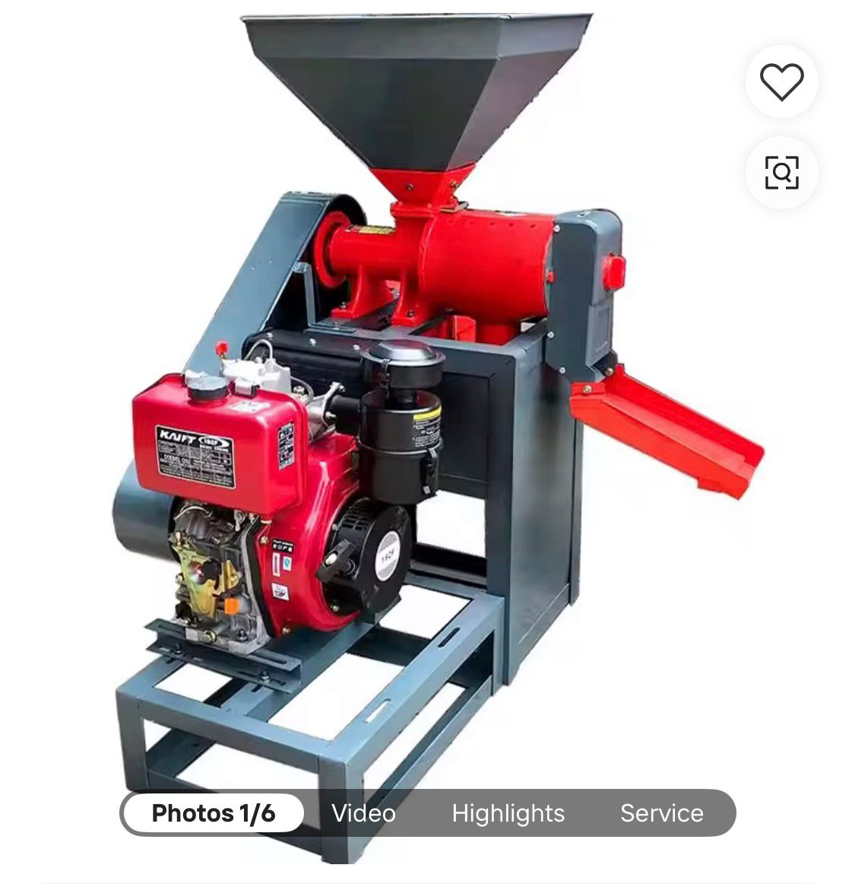
Process Flow
Oil Seed
Animal Feed
Organic Cooking Oil

Slide 4
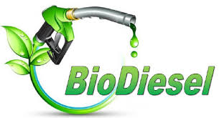
Testing results from SGS on Diesel (Excellent results achieved)
Testing done on Vehicle performance with Diesel from our Factories.
N/m Torque: >10Nm.
Break Horse Power: >8 BHP.
Emissions: Down from 11.1 to 6.7

Slide 5
Low Carbon liquid fuel Testing with SGS
Leading Internation Accredited Laboratory
Results: Our Liquid Fuel is of the Highest Quality Diesel tested World Wide

Slide 6
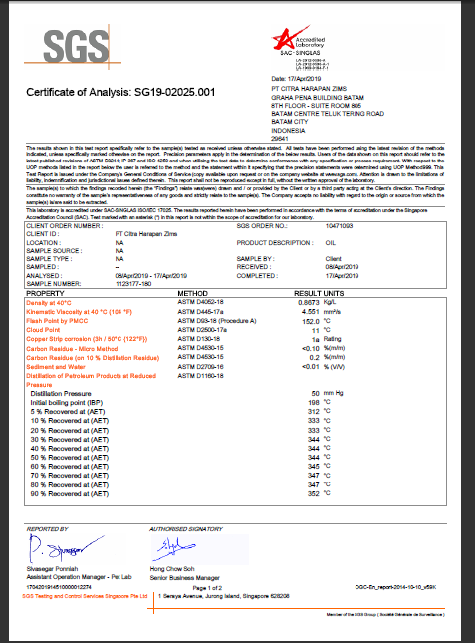
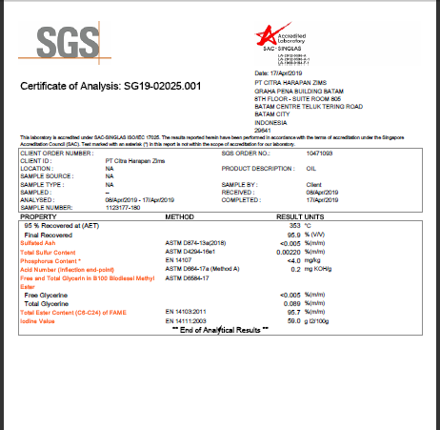

Slide 7
Tests conducted using an accredited Dyno testing facility
Results: Brake Horsepower > 8
Newton Meter Torque > 10

Slide 8
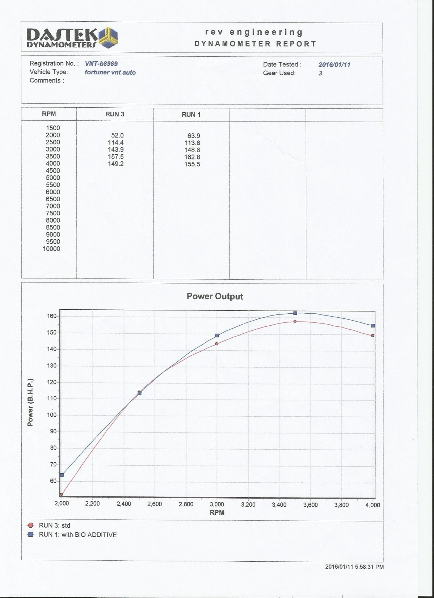
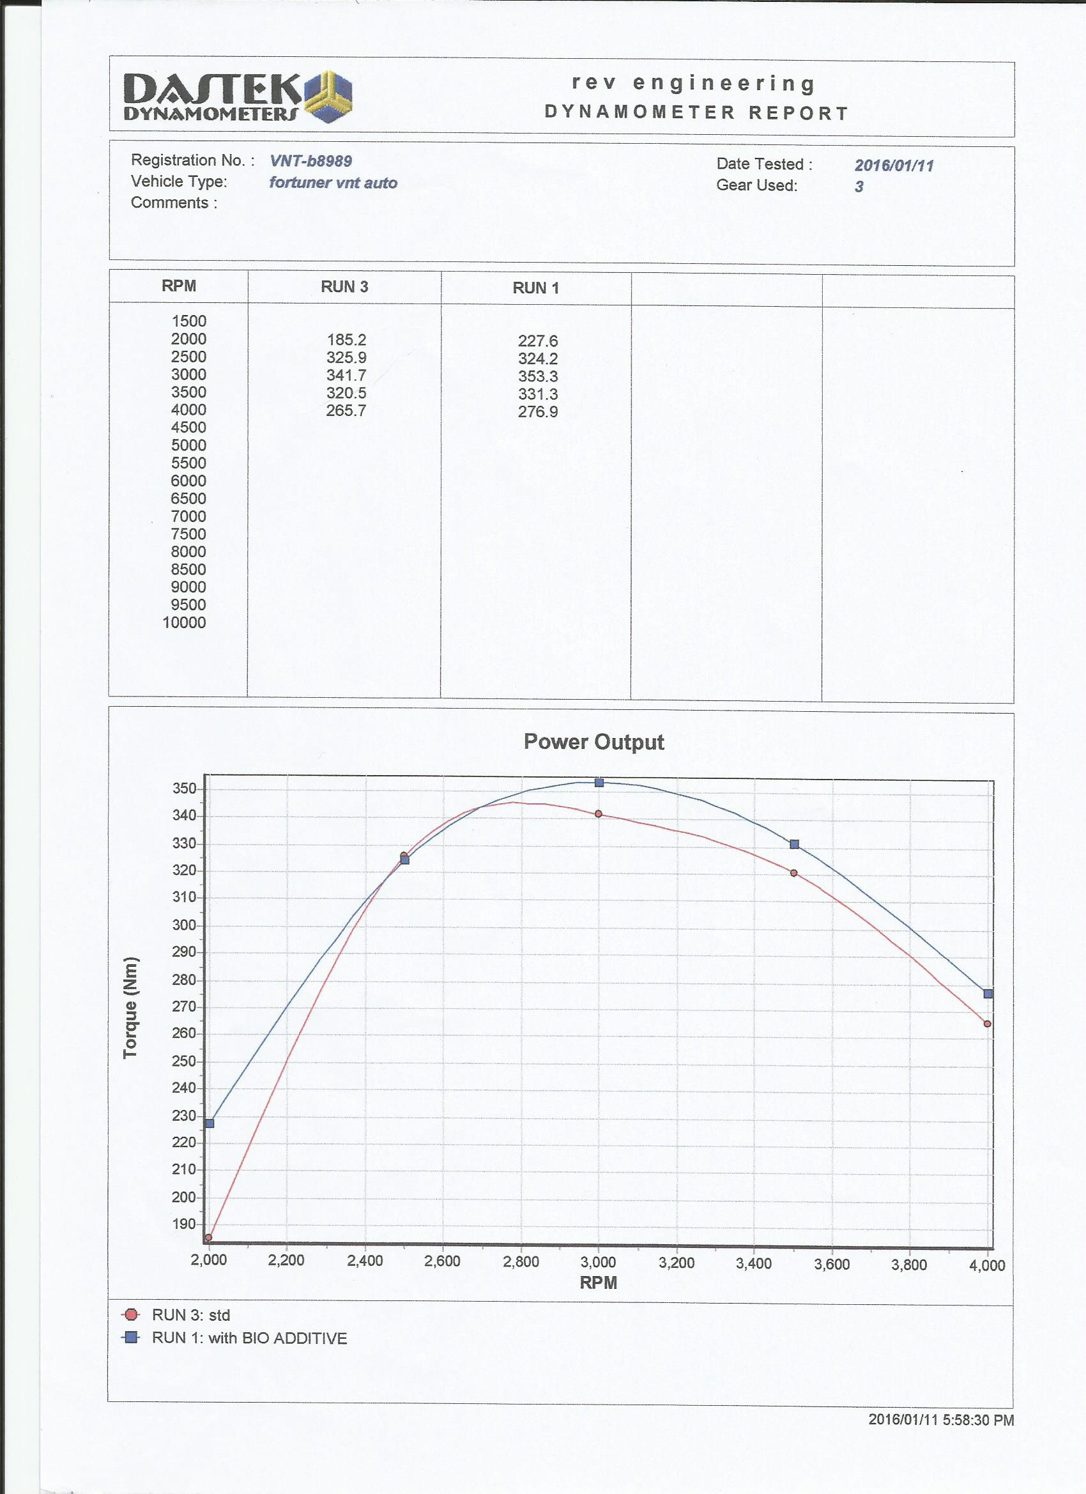

Slide 9
Tests conducted on Emissions
Results:
Emissions > 40% reduction

Slide 10
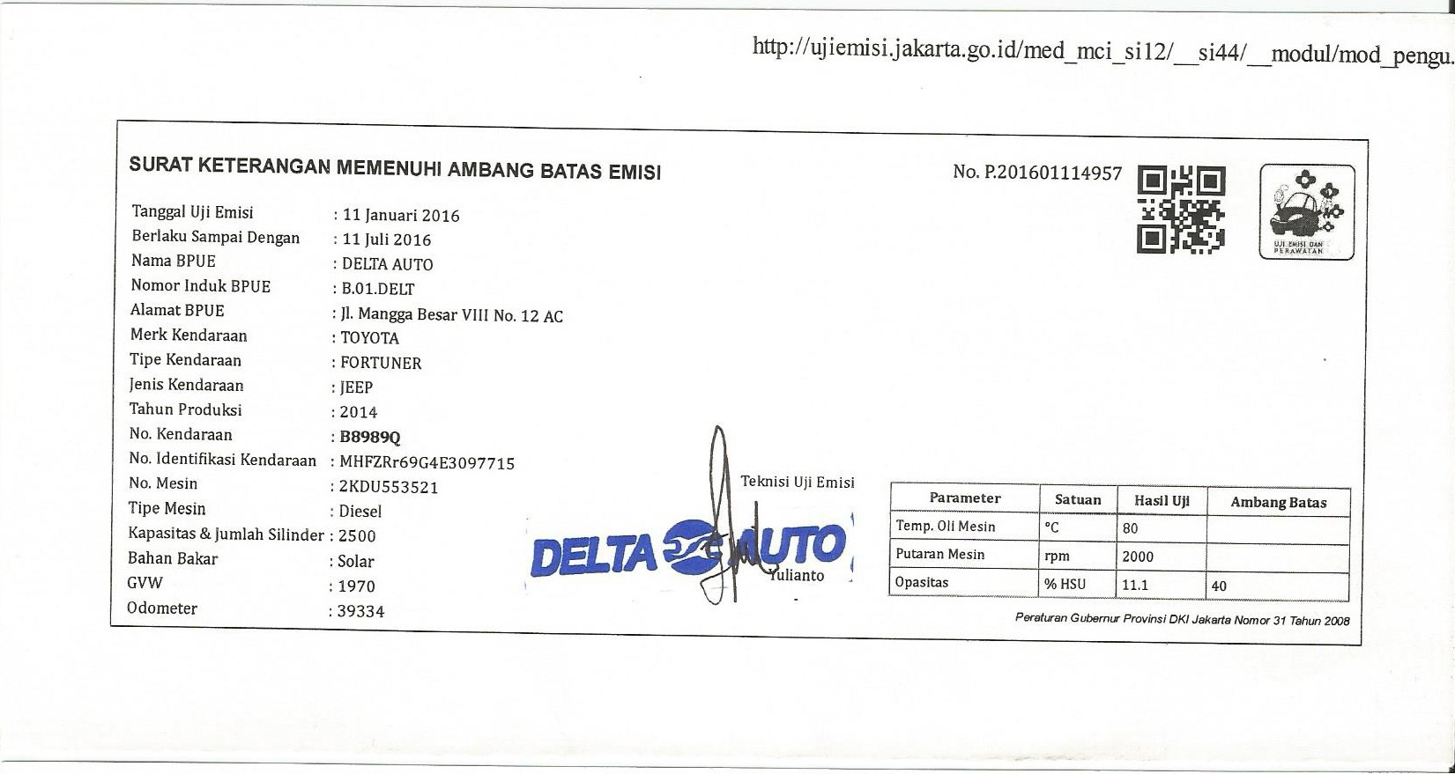

Slide 11
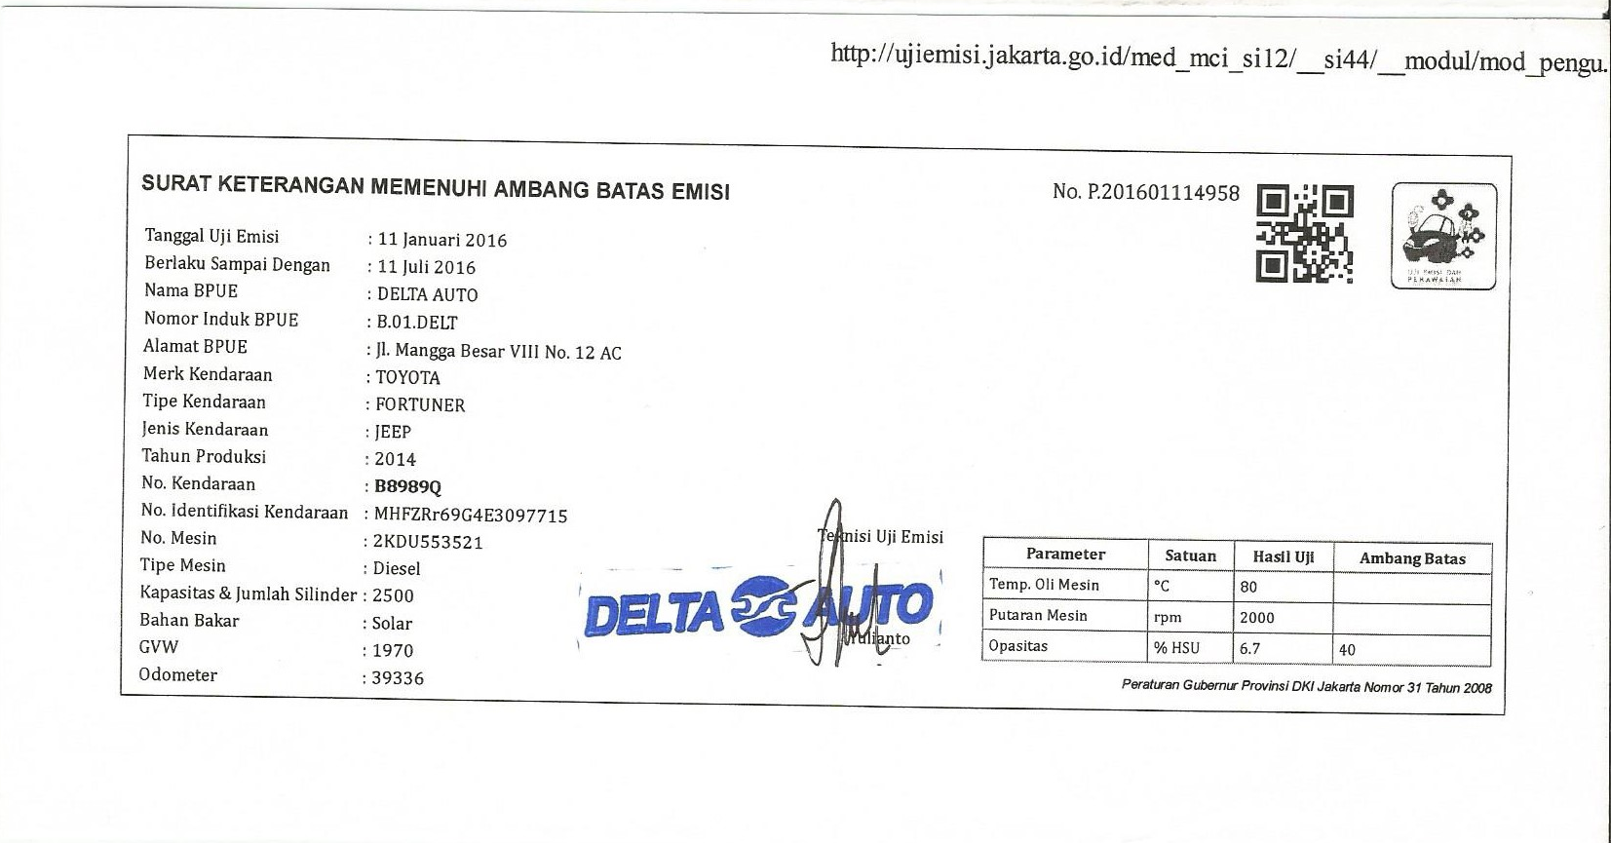

Slide 12
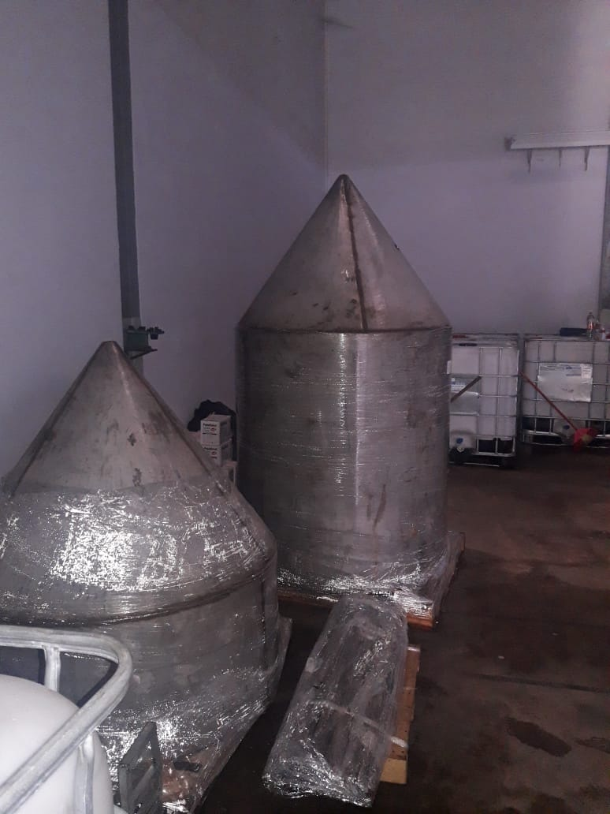
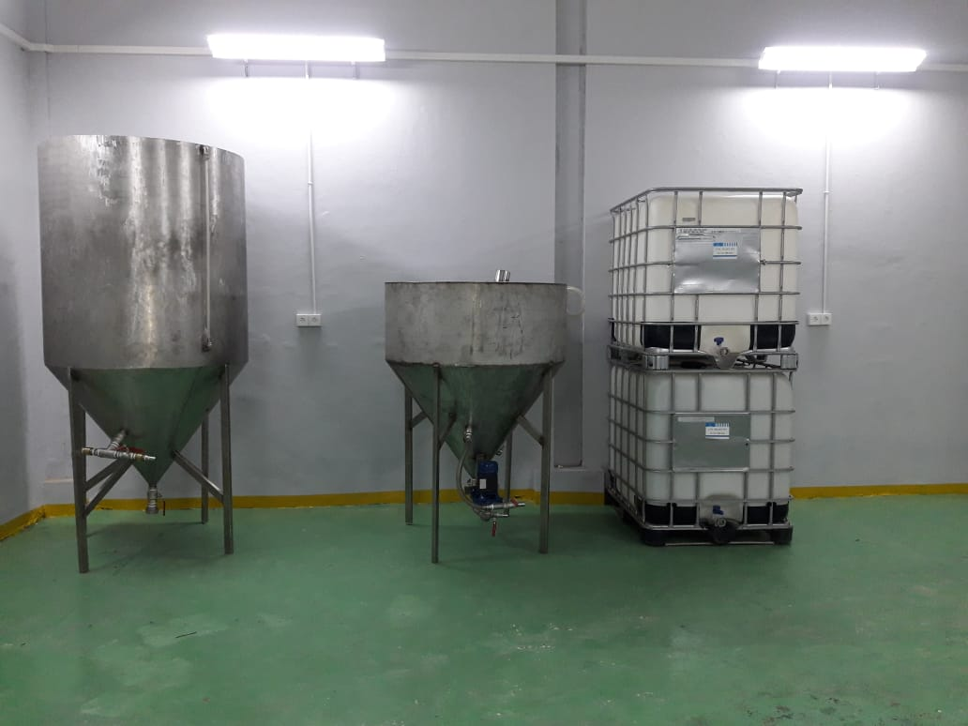
Manufacturing Diesel fuel Reactor stages, in Batam Indonesia

Slide 13
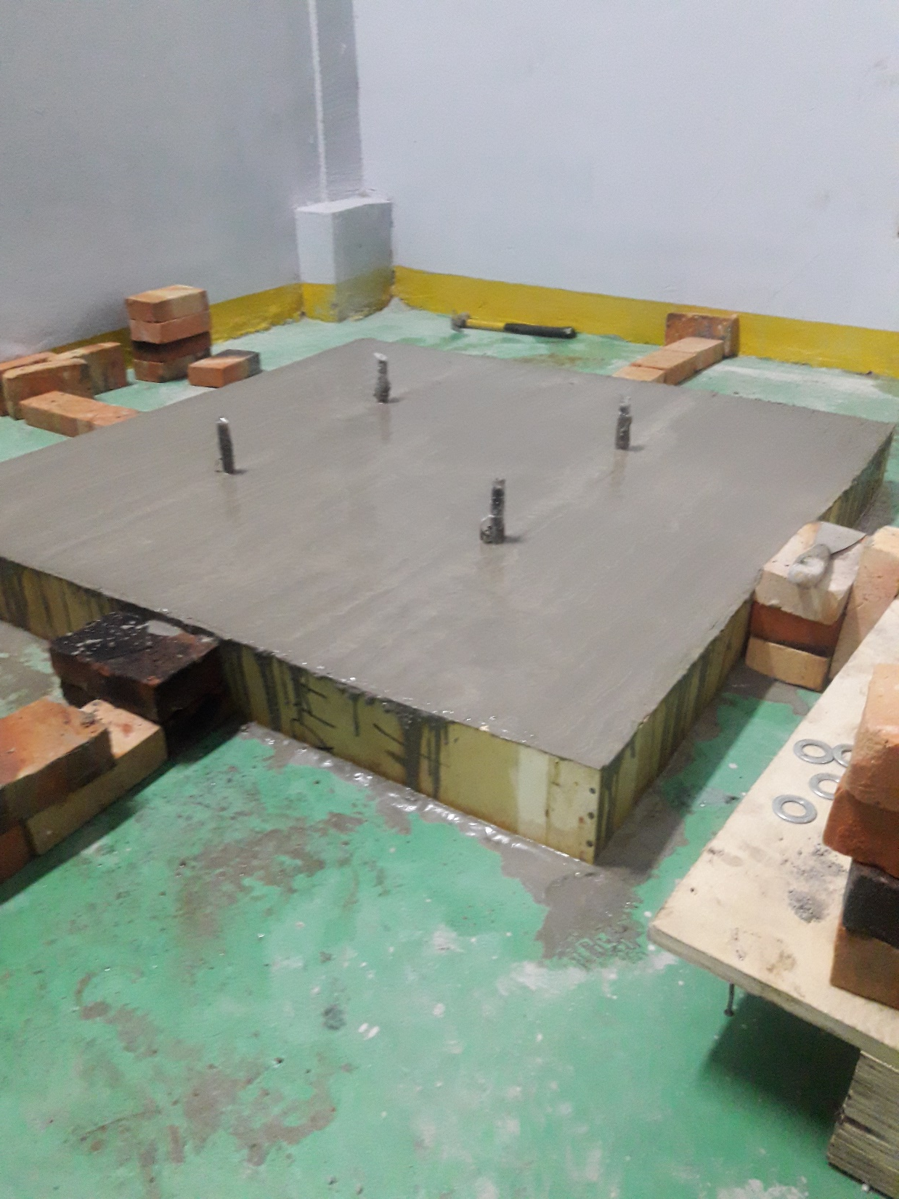
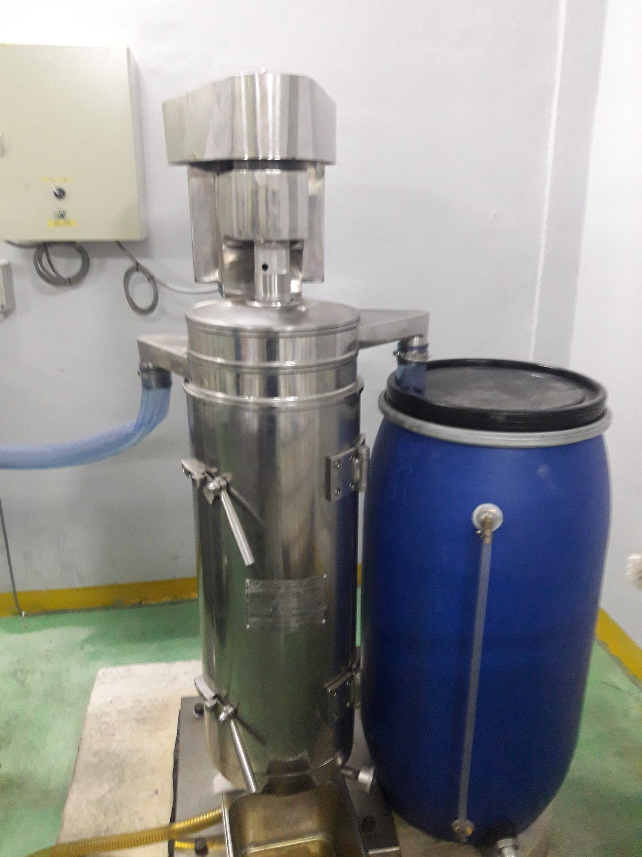
Constructing the Base for the High Speed Centrifuge
High Speed Centrifuge Installed.

Slide 14
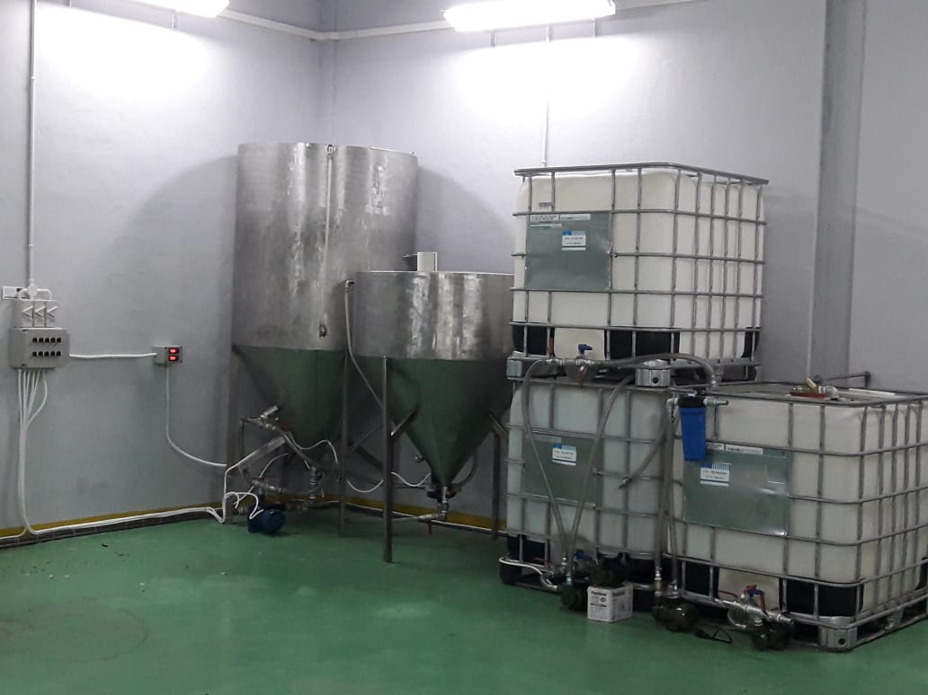
Production Efficient
Enzyme conversion Technology.
High Velocity Jet Technology.
Cost Effective.
High Quality Output.
Easy to Maintain.
Easy to Operate.
120T Output/Month
Quality Tested.
Comply with International Standards.
Heat Exchange Technology.

Slide 15
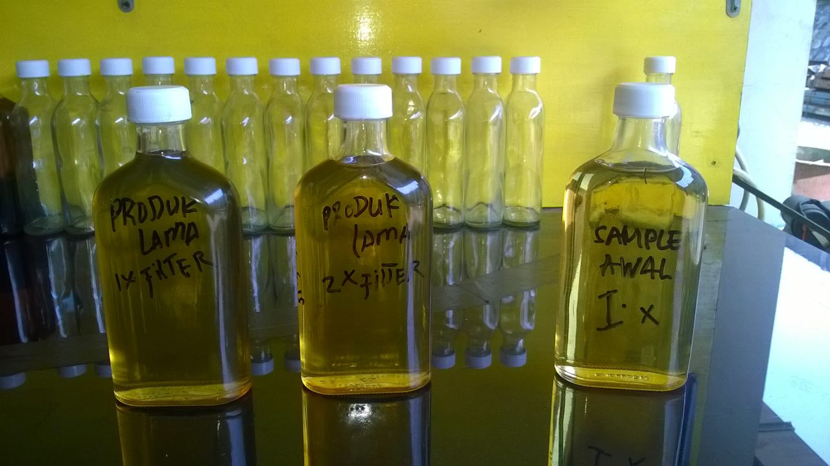
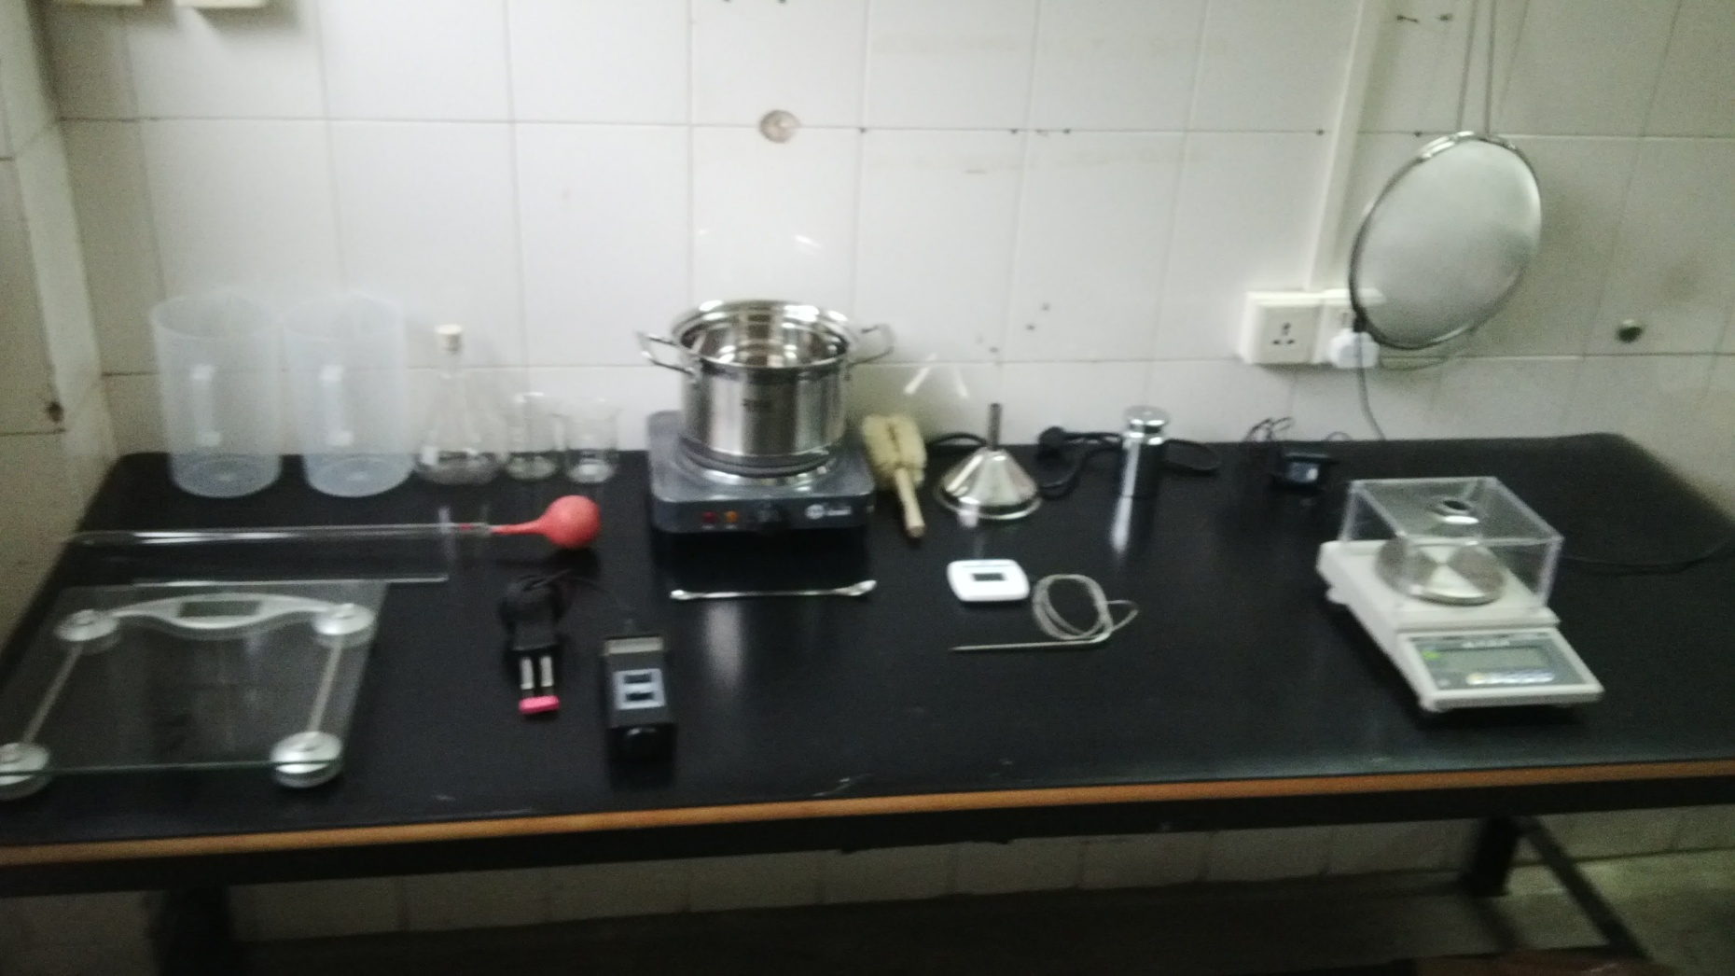
diesel Quality during Processing

Slide 16
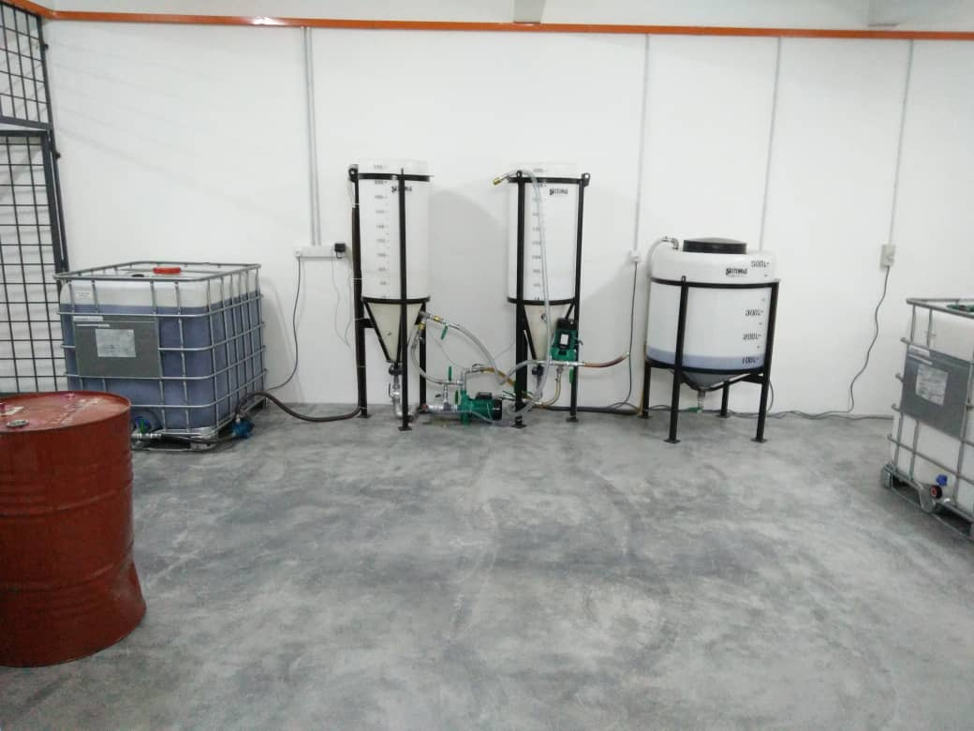
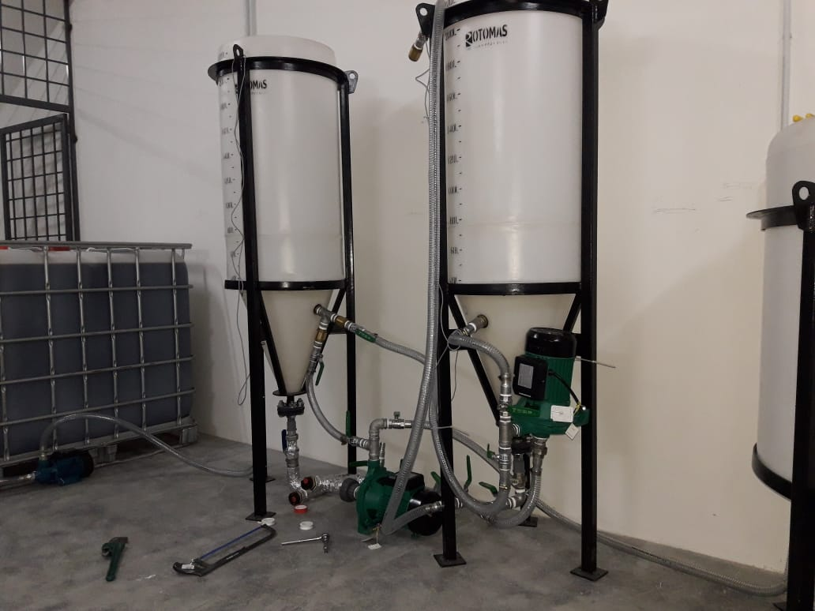
Manufacturing a Smaller output Plant in Malaysia

Slide 17
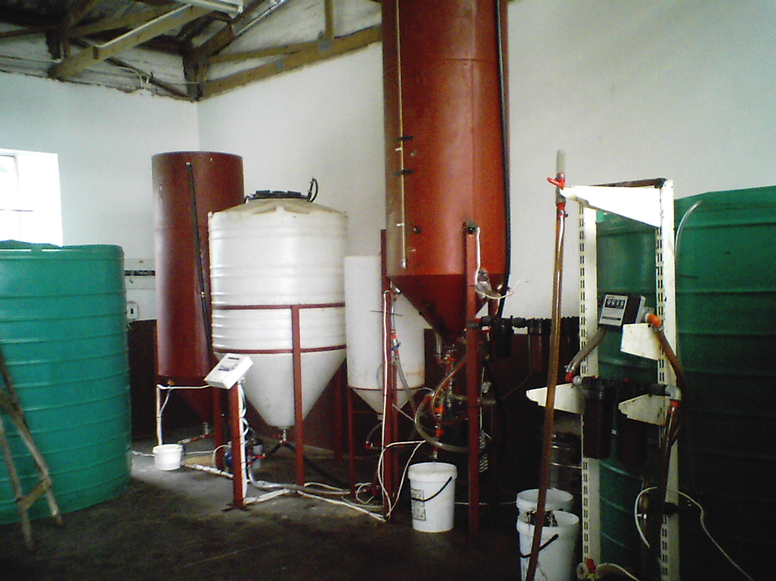
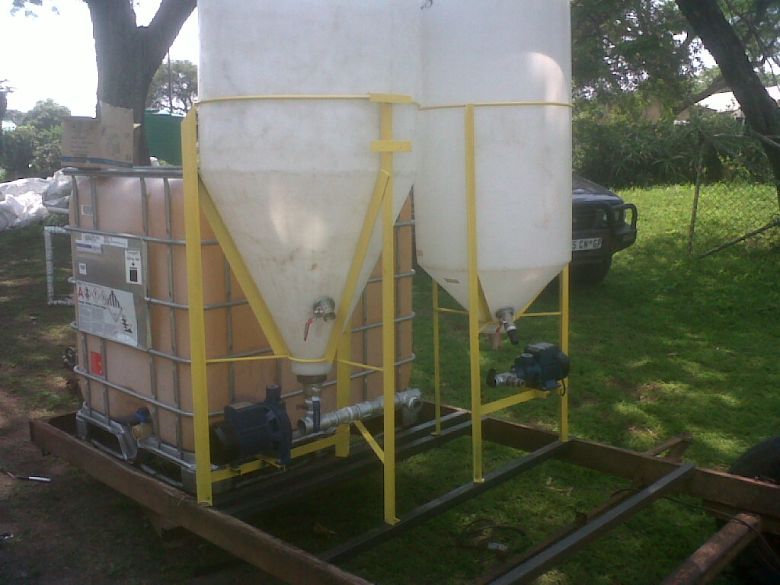
Customers in South Africa
large Output Facility built
Mobile Manufacturing Facility in Construction

Slide 18
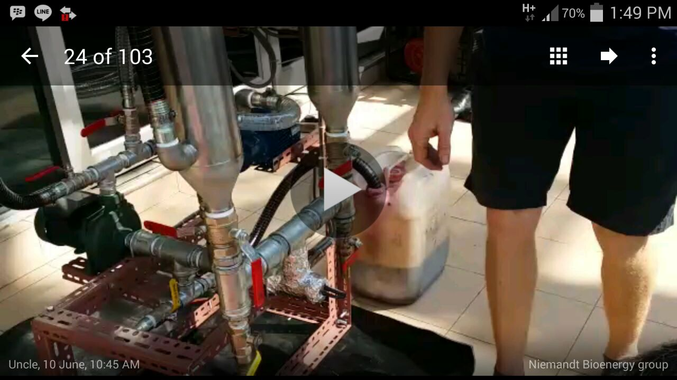
A Micro-Diesel System For a Singapore Construction Company

Slide 19
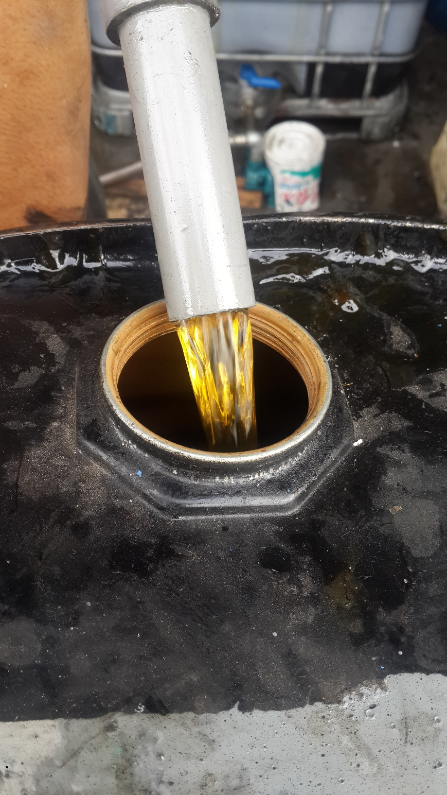
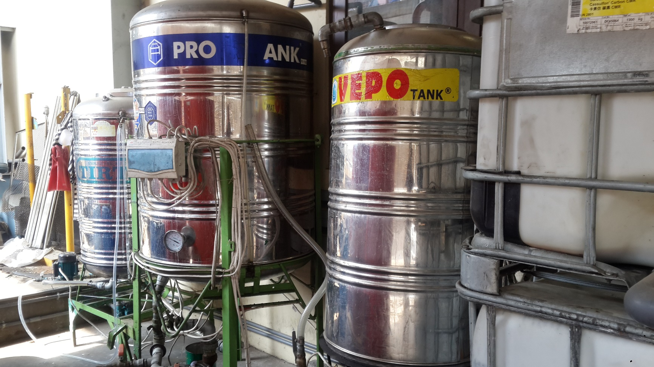
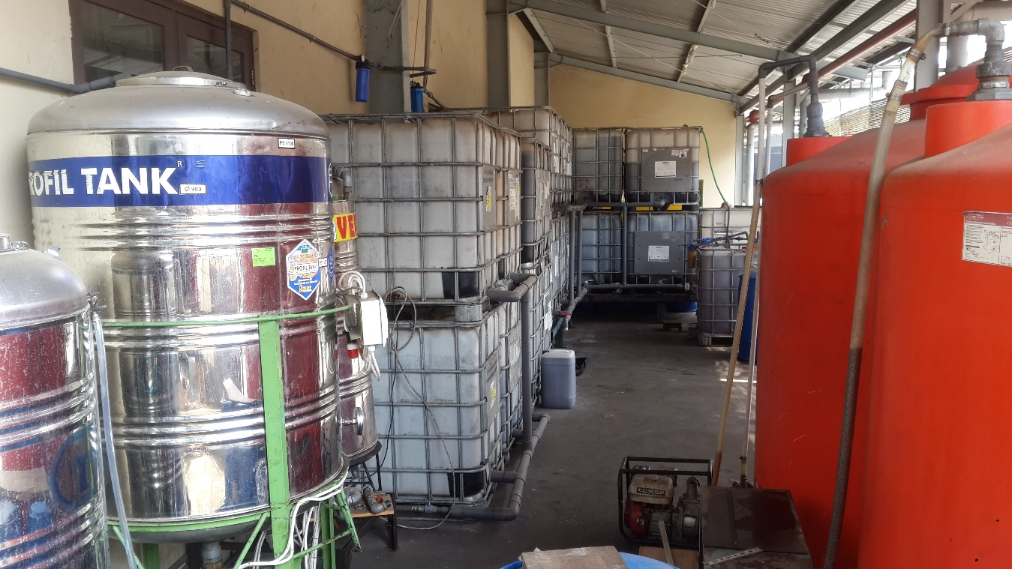
Large Diesel Plant Built in Semarang Indonesia

Slide 20
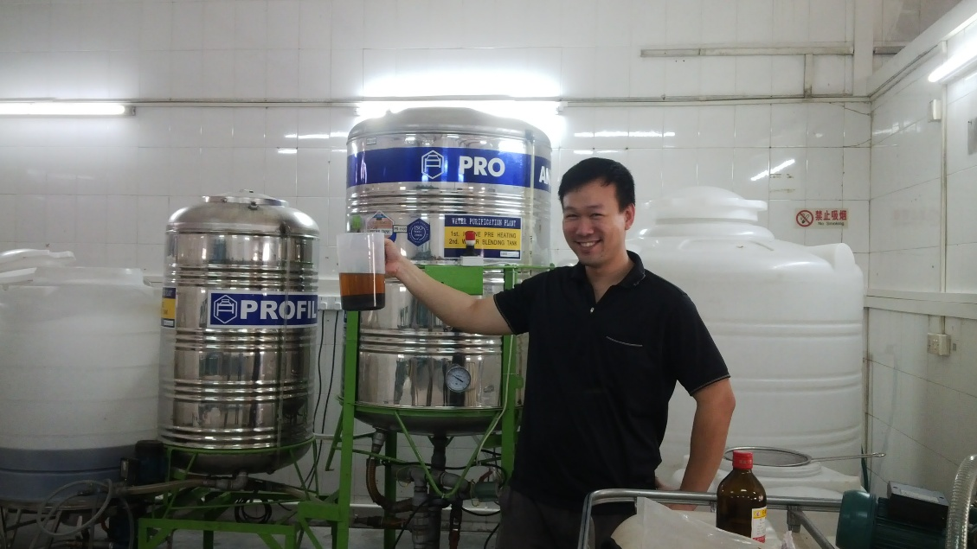
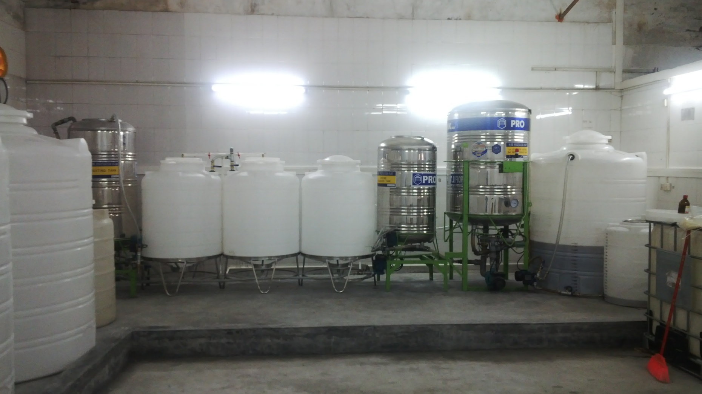
Large Diesel Plant Built in Zhuhai China

Slide 21
Product ranges (Only Oil Plant Base)
Various viscosities of lubricants available/Grease Products
Heavy oils (optional Extra)
Light oils (optional Extra)
Light Grease (optional Extra)
Heavy Grease (optional Extra)
Fibre Grease (optional Extra)
Grease Cake (optional Extra)
Light Diesel ( Jet Fuel)
Vehicle Diesel

Slide 22
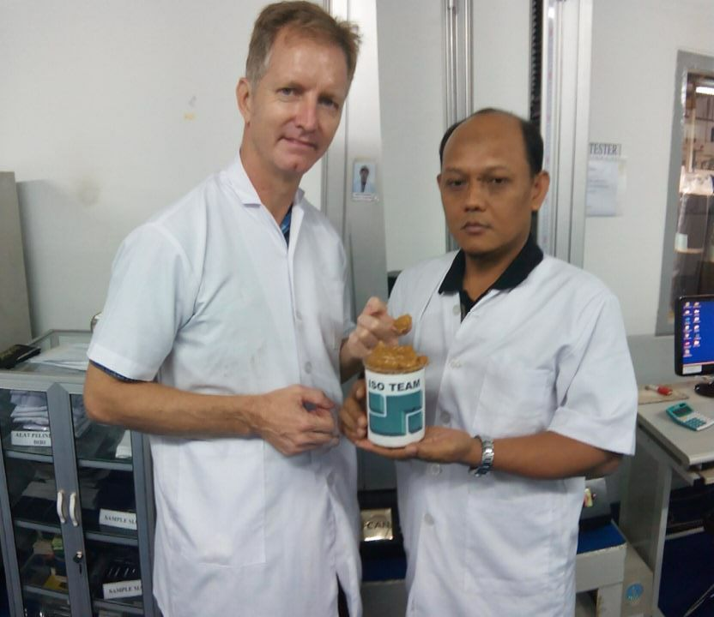
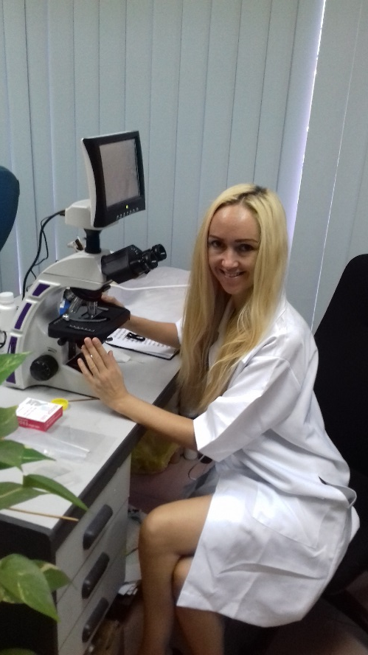
Continuous research & Development into Plant oil based lubricants and Greases

Slide 23
Recent International Customers
China: Zhuhai, Built an advanced Factory in Producing an Organic Fuel Additive to reduce Carbon Emissions.
Myanmar: Mandalay, Providing Technical advise to Government on Jatropha Plantations for Diesel Production.
Europe: Lichtenstein Provided Technical Advise on Diesel Oil Plantations for Asia & Diesel Manufacturing Technology (2nd Generation Biofuel: Roland Jansen) Establishing a Green Bond Funding Initiative to grow Oil Plantations for Asia.

Slide 24
Cost per Unit
120T/Month: USD 350,000.00
80T/ Month: USD 300,000.00
60T/Month: USD 230,000.00
30T/Month: USD 150,000.00
The above excludes, Iabor, accommodation & meals for 3 weeks to 6 weeks
The above costing does not include Technology Transfer, only a license to Produce, technology transfer negotiable
Note: if you consider larger capacity than 120T/month, we recommend to combine more plants instead of 1 Large plant, the benefits are:
Better Efficiency.
Continuous production in the event of Regular Maintenance Shut downs or Break down events.
Ease of Production, less Staff required.
Safety aspect.

Slide 25
Business Concept:
Extrude Australian Grown Canola/Sunflower Oil using our Complete Organic Oil Extrusion Technology *No Import Cost*
The Organic Canola Oil is sold to the market on the agreement to swap for the used oil (normally free of Charge)
Used Oil is collected at the same time New oil is delivered
Used oil is converted to Biodiesel using a Unique Enzyme Technology to create no waste appose to Conventional Diesel processes.
To produce the diesel using our technology cost an average of AUS$ 0.70c Lowest cost than any other processing.

Slide 26
Diesel Technology
Our Process has no waste Product like conventional diesel factories(No Glycerol)
Enzymes used in the process are recovered to produce a sole carbon base for Soil Microbe Technology
Soil Microbe Technology is a world 1st which is used in commercial farming operations to remove all Pollution (Methane, Ammonia, Nitrogen) from animals, kills Cockroaches, Flies, Lice etc. Converts animal fecal matter into a High-End Protein source to feed other animals
Animal Production increases by 20% due to the increased Digestive enzymes as a result from the Soil Microbe Technology.
A 2nd addition is the development of Plant based Lubricants for Vehicles.
The offset involved in selling the Soil Microbe as a Main Product makes the Diesel as the By-product a free or a 100% Profit Product

Slide 27
THANK YOU

